Slide 1
Verifiable Information Exchange for
Virtual Asset Service Providers
Vytautas Vito Tumas
vytautas.tumas@uni.lu
Robert Norvill
robert.norvill@uni.lu
University of Luxembourg
SnT, University of Luxembourg
Notes:
Intoduction: Hello everyone thank you for joining, my name is VIto Tumas

Slide 2

Financial Action Task Force (FATF)
International organisation founded to develop policies to combat money laundering and terrorist funding
Late 2018 introduced Recommendations 15 and 16
Recommendation 15:
  Virtual Asset Service Provider
  Virtual Asset
Recommendation 16:
  Travel Rule
Notes:
Recommendation 15 - definition of Virtual Asset Service Provider and Virtual Asset
VASP is any natural or legal person which transfers, holds, or otherwise handles virtual assets on behalf of another natural or legal person
any digital representations of value that can be digitally traded or transferred and can be used forpayment or investment purposes”. In practice, VAs include cryptocurrencies and digital representations of equities and financial instruments, and VASPs are the entities that handle these, such as cryptocurrency exchanges for example
Recommendation 16 - Travel Rule requires VASPs to disclose certain information about transacting parties
OpenVASP - a distirbuted model
TRISA - centralized model
InterVASP - messaging prtocol

Slide 3

VASPs publish their identity via standardised Smart Contract on the blockchain
Identity vouched for by direct peers and 3rd parties via claims on the blockchain
In case the private key is compromised VASP identity can be stolen
Notes:
OpenVASP: A VASP posts their identity on the blockchain via a standardized smart contract, the identiy is proved by direct peers and trusted third parties with identity claims on the blockchain.
The downside is in case the VASPs PK is compromised, the identity can be stolen

Slide 4

Identity proved via X.509 certificate
Identity certificates issued by a trusted third party
VASPs verify identity by exchanging certificates
Certificate authority becomes a centralized point of failure
Notes:
Trisa takes a fully centralized approach, where identity is proved by a x509 certificate, which is issued by a trusted third party.
SSL ike process is then used to verify the identity.
The CA becomes a centralized point of failure

Slide 5
Restrictions, Regulations & Embargos
High risk assets
Financial laws and regulations
Trade restrictions and embargos
Notes:
FATF regulations are not legaly binding, they are implemented as laws in the member countries, that also have various trade restrictions, financial regulations and embargos that VASPs have to follow.
VASPs provide cheap, rapid cross border payments that can invlove multiple VASPs all located in different jurisdiction. To remain compliant, VASPs require a method to identify and control with whom they conduct business (both directly and indirectly)

Slide 6
Introduction
VaVite

Slide 7
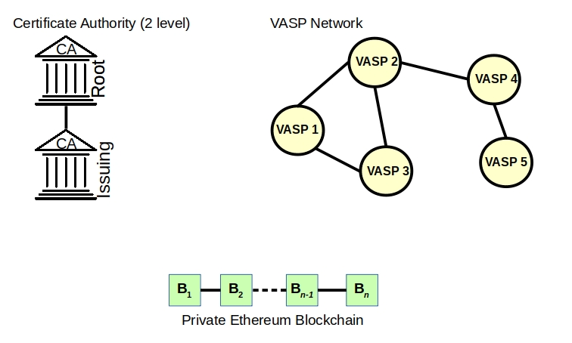
VaVite Overview
A network of VASPs each running a full Ethereum node
Two Tier certificate authority
Private,Permissioned Ethereum Blockchain

Slide 8
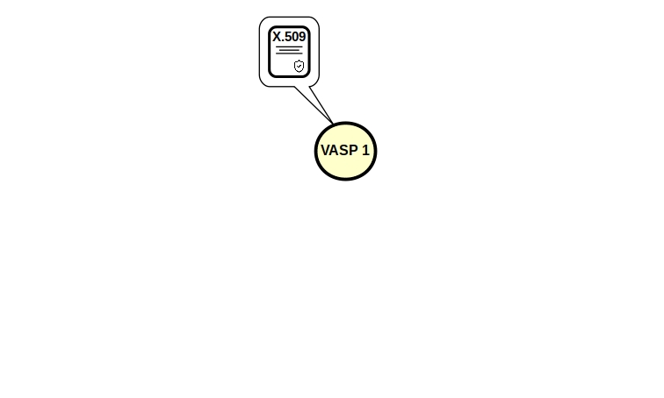
Improved VASP Identity Management
VASP identity proved via X.509 certificate

Slide 9
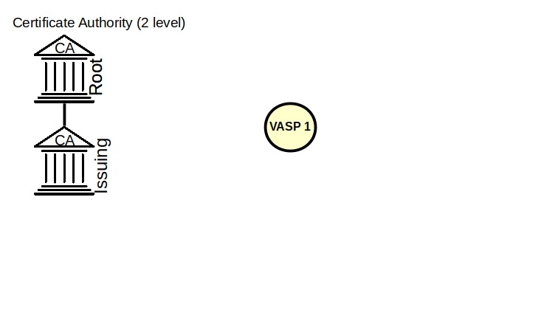
Improved VASP Identity Management
Certificates issued by financial regulatory bodies in VASP’s jurisdiction
Certificate Authority chain limited to 2
Notes:
USA: Security and Exchange commission (SEC)
LUX: Financial Sector Supervisory Commission (CSSF)

Slide 10
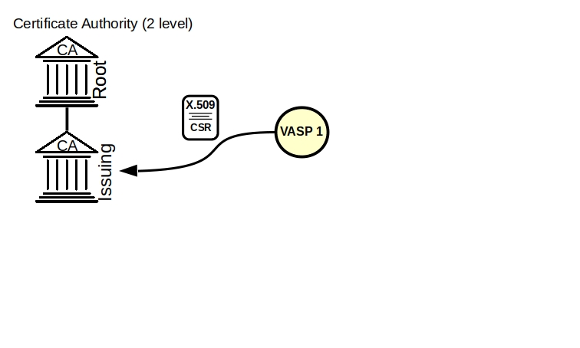
Improved VASP Identity Management
X.509 certificate issued through the standard CSR request
CSR contains the information needed to perform KYC checks
Ethereum Public Key in CSR
VASP Identity Code in CSR

Slide 11
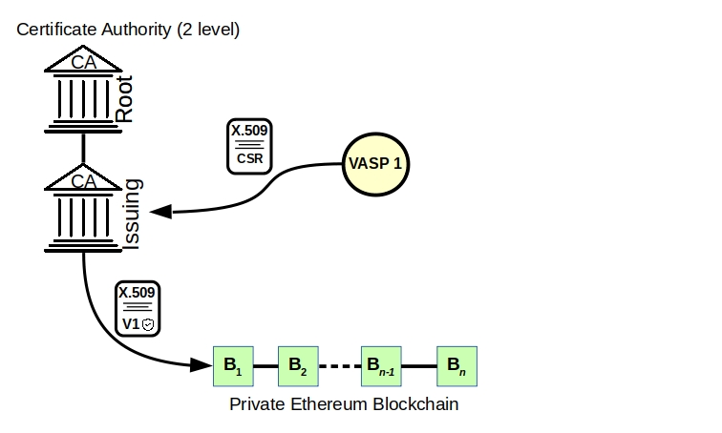
Improved VASP Identity Management
Certificate Authority manages certificates through it’s Smart Contract
Upon signing certificate is saved on a private, permissioned Ethereum blockchain

Slide 12
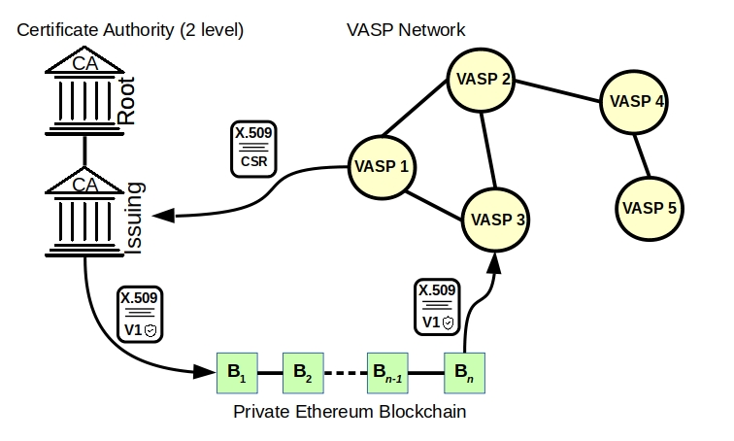
Improved VASP Identity Management
VASPs can participate in the network only when their certificate is on the blockchain
To verify the identity of a VASP its’ certificate is retrieved from the blockchain using the VIC
Certificate is revoked by invalidating it on the blockchain

Slide 13
VASP Identity Code (VIC)
VASP key pairs are ephemeral
When key pair changes, so does the Ethereum address of the certificate
VASP Identity Code (VIC) acts as an alias for the Ethereum address
Institution Code | Country Code | City Code | Branch Code (opt)
VASP | LU | LU | 01
VASP | LU | LU | 02

Slide 14
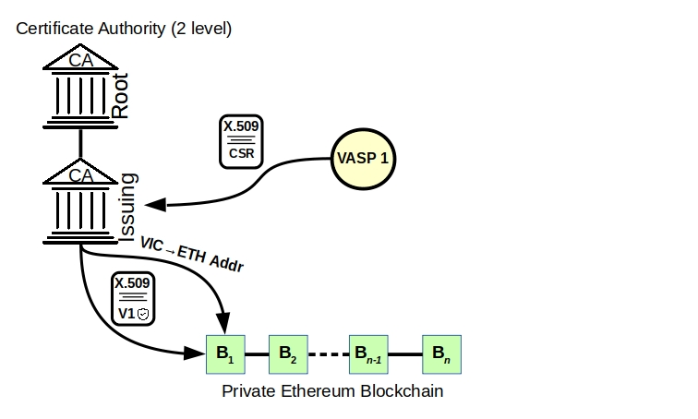
VASP Identity Code (VIC)
VIC -> Addr mapping stored at well known smart contract by the CA

Slide 15
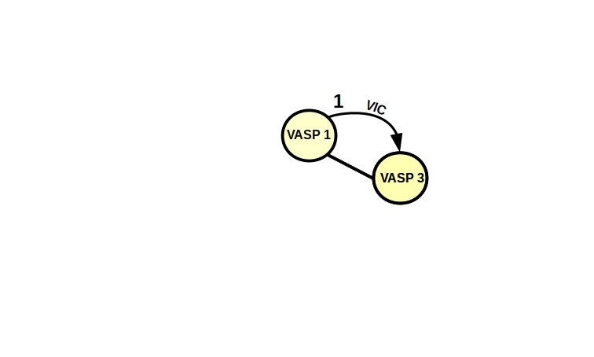
VASP Identity Code (VIC)
VASPs can prove their identity by sending a signed VIC to the recipient

Slide 16
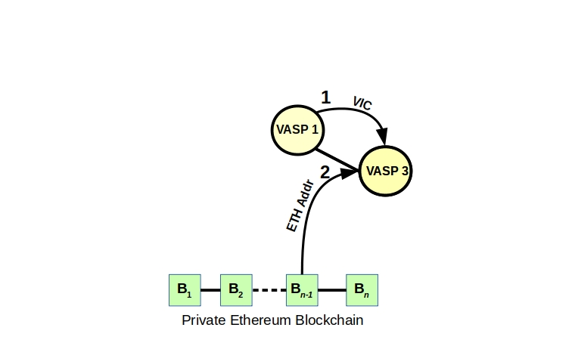
VASP Identity Code (VIC)
The recipient of the VIC fetches the Ethereum address of Certificate from the blockchain

Slide 17
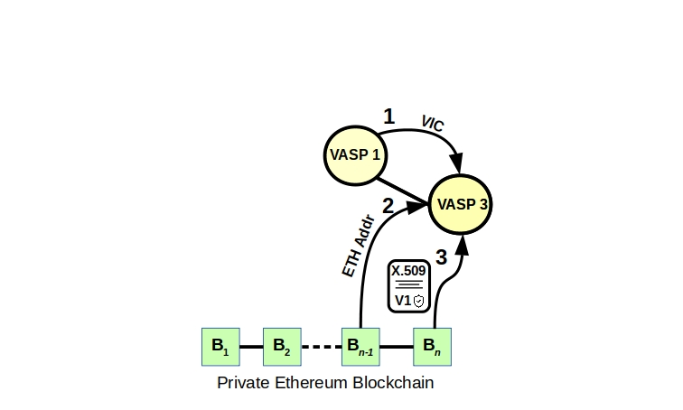
VASP Identity Code (VIC)
The Certificate is retrieved from the blockchain using the ETH Address
The signed VIC is verified with the public key in the certificate

Slide 18
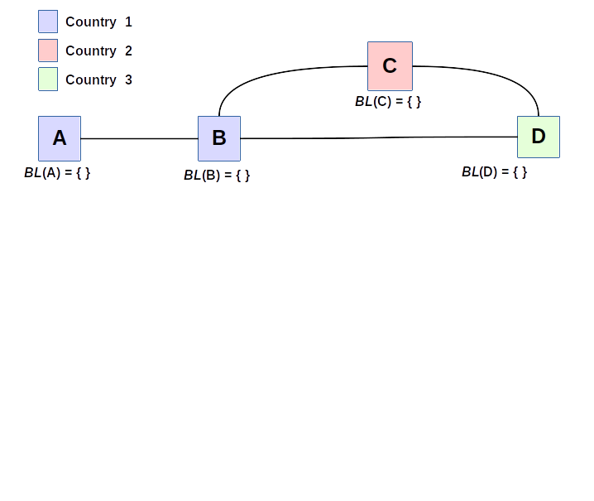
Trade Restriction Compliance

Slide 19
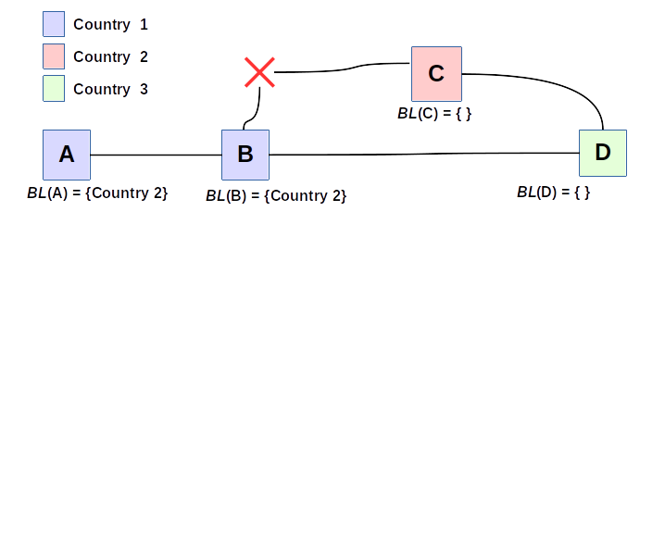
Trade Restriction Compliance

Slide 20
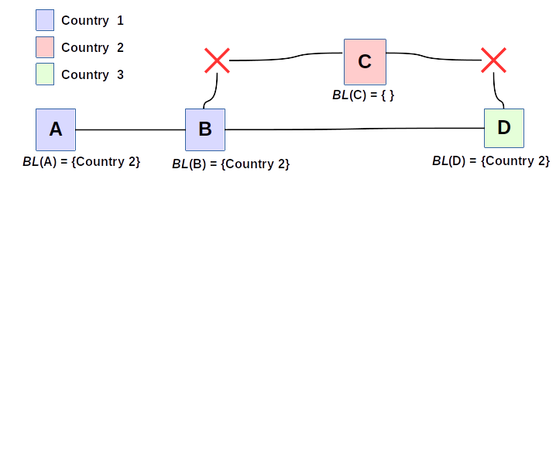
Trade Restriction Compliance

Slide 21
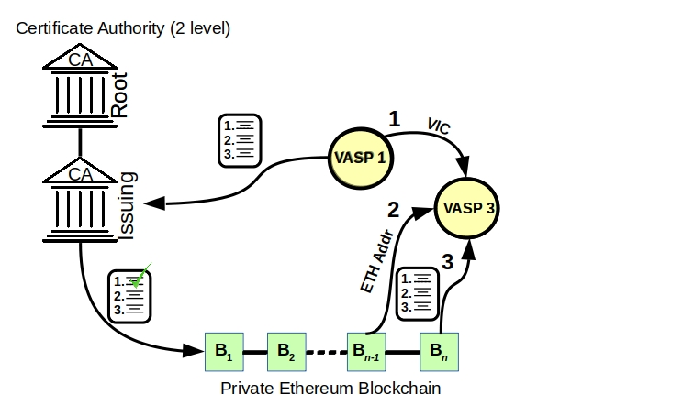
Trade Restriction Compliance (Rules)
A rule identifies a Virtual Asset or countries a VASP is unwilling to conduct business with
Rules are verified and stored on the blockchain via the Certificate Authority
Rules are consulted to establish a business relationship and payment path

Slide 22
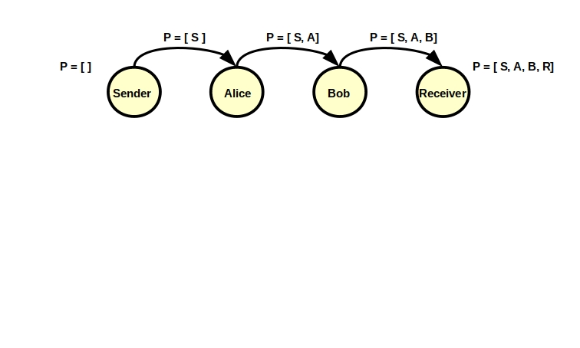
Verified Path Establishment
Signed participants VICs are accumulated during the path establishment

Slide 23
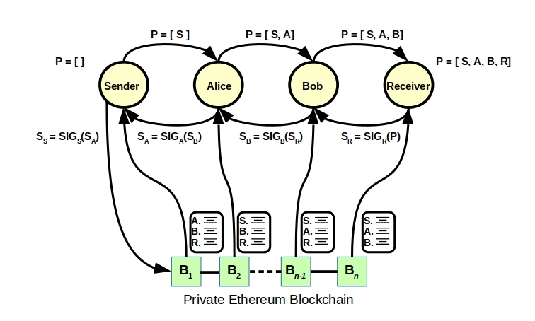
Verified Path Establishment
On the return each VASP verifies the rules of every other VASP
Each VASP signs the previous signature, this acts as an agreement to participate in payments over a path
The original sender saves the nested signature on the blockchain for posterity

Slide 24
Future Work
Perform performance analysis of identity management and verified path establishment
Implement the protocol with an existing payment channel network

Slide 25

Thank You
vytautas.tumas@uni.lu

