Slide 1


There’s Nothing Artificial About Our Intelligence
By Alex Gruber
Vice President of Product & Design
Carbyne

Slide 2

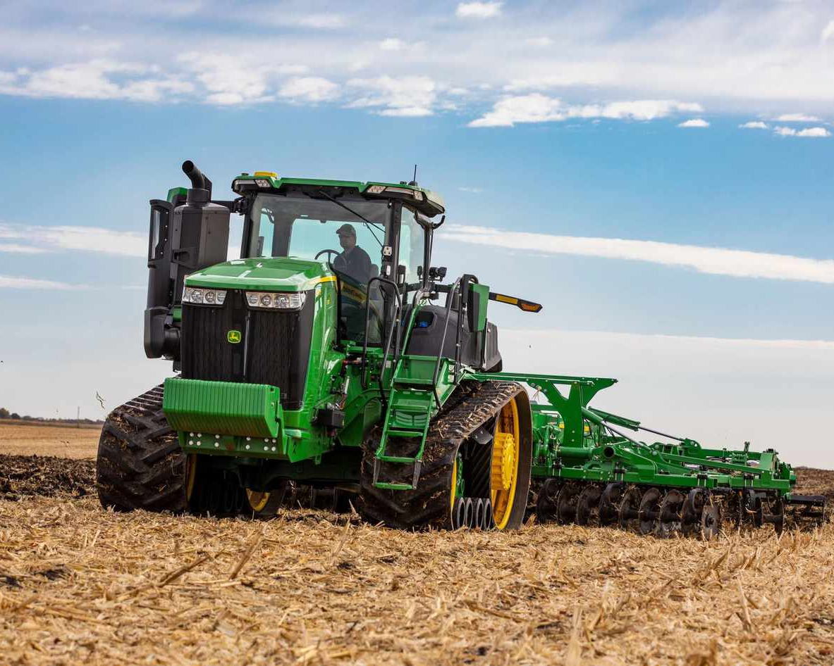

www.carbyne.com
The Tractor Didn’t Replace the Farmer
Notes:
Chance is always hard and it creates some fear of the unknow
We try to resist it, but when we adopt it, the outcomes are possitve

Slide 3


www.carbyne.com
The Calculator Didn’t Replace the Mathematician
Notes:
AI allows us to accelerate work, it will be the assistant the helps us achieve our goals
But it needs to be applied correctly and in public safety, it needs to be applied with great care and thoughtfulness

Slide 4
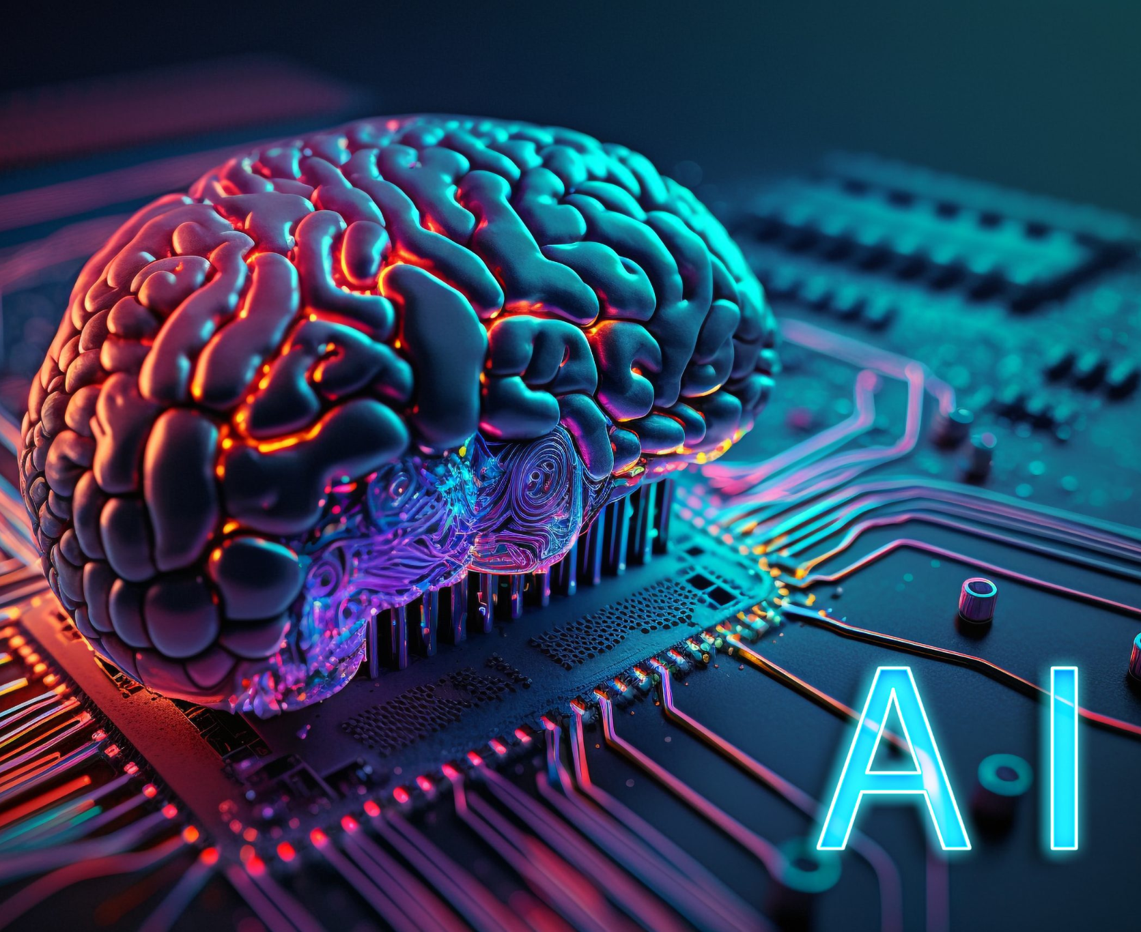

www.carbyne.com
AI Won’t Replace Humans - but can Give us Superpowers!
Notes:
AI is and will be a force multiplier
Data processing
Identifying the signal from the noise
Brain storming
Will all be improved with AI
We are seeing amazing results in healthcare and education with AI
We are just at the tipping point of AI implementation

Slide 5

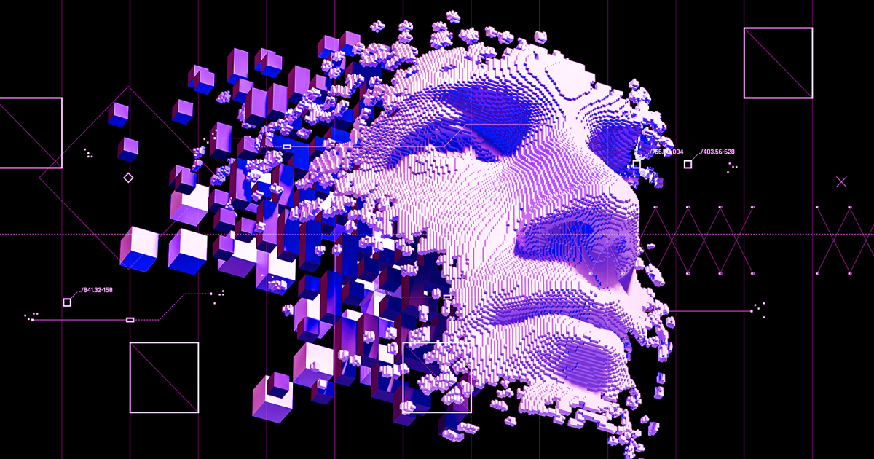
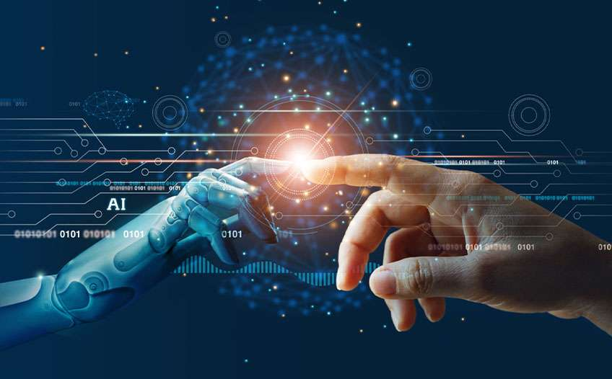
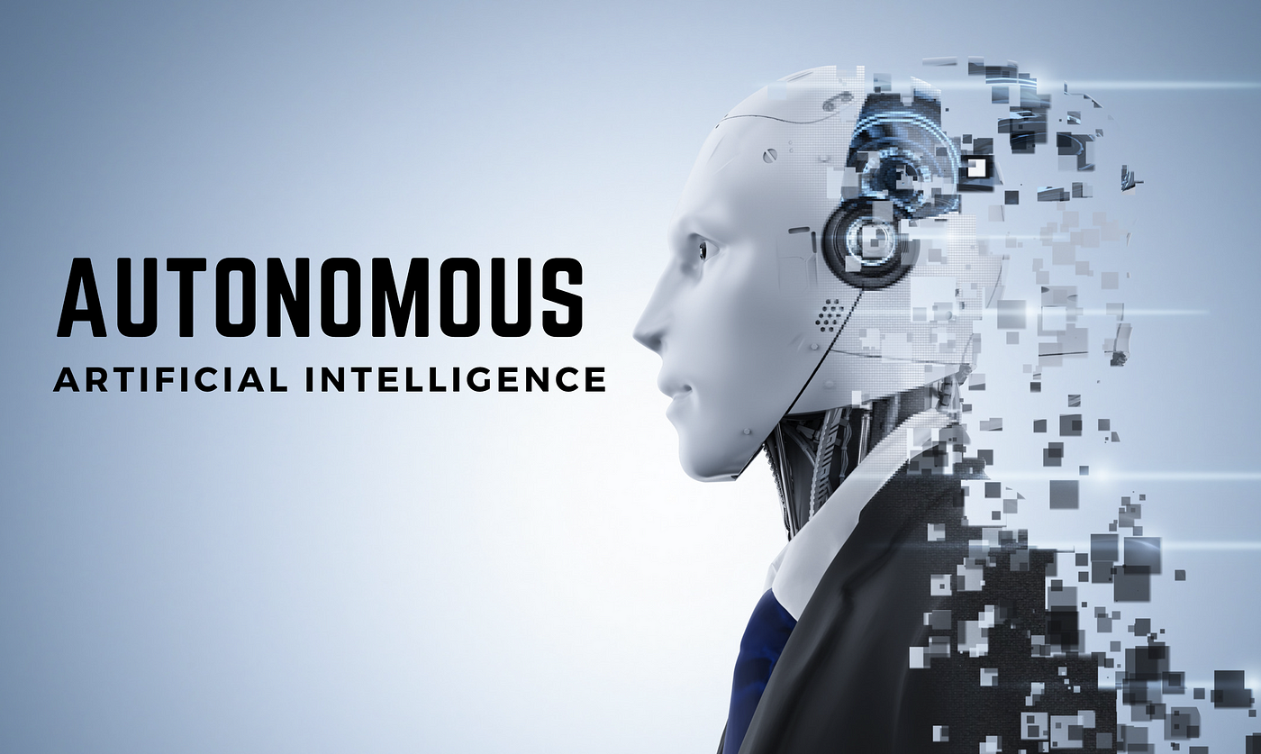
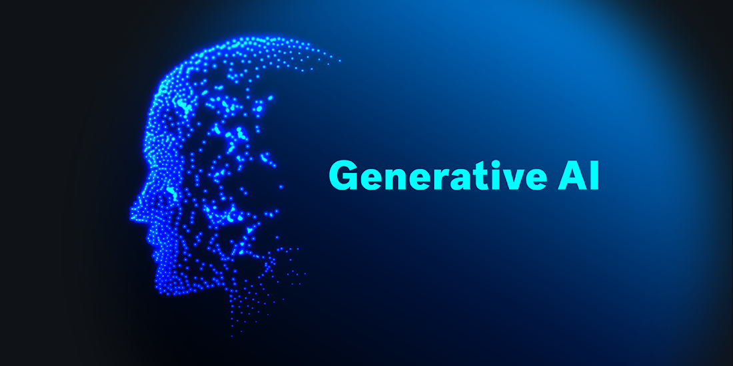

www.carbyne.com
Evolution of Artificial Intelligence
Predictive
AI
Generative
AI
Autonomous AI
Agent
AI
Artificial General Intelligence (AGI)
Notes:
Predictive = Weather, Pensioning of resources
Generative = Large Language Models (LLM) ChatGPT, conversational
Autonomous = Cars, Planes and Trucks.
Agent = Thermostats
AGI = Human Like

Slide 6

www.carbyne.com
AI Reduces Mundane, Repetitive Tasks

Slide 7
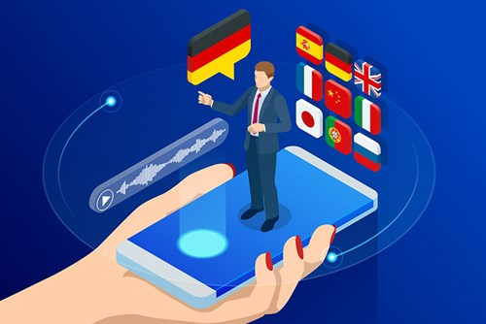
www.carbyne.com
Avg. 9-1-1 call takes 2 mins, but foreign language calls take 8+ mins.
→ AI Accelerates Emergency Response
Notes:
Delays in getting a translator
Interpretation vs translation
Accuracy & Speed
Available Languages

Slide 8
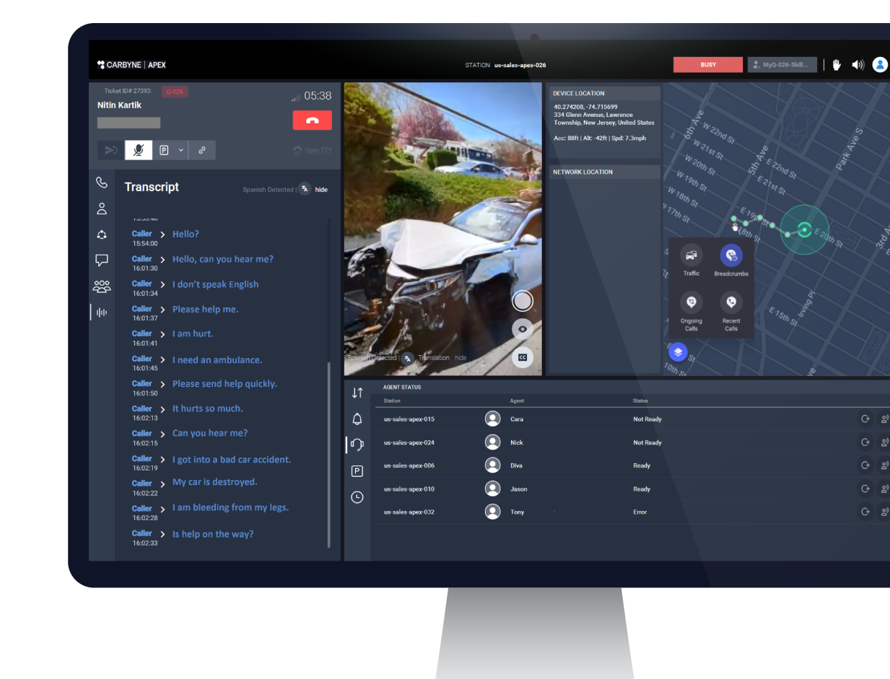
www.carbyne.com
AI-Powered Translation:
Automatic Language Identification
Translated Audio
to Caller
On-Screen Translation for
Call Taker
Multilingual Support
Notes:
Delays in getting a translator
Interpretation vs translation
Accuracy & Speed
Available Languages

Slide 9

www.carbyne.com
Quarter Billion
9-1-1 Calls annually
→ AI Identifies the Signal within the Noise

Slide 10
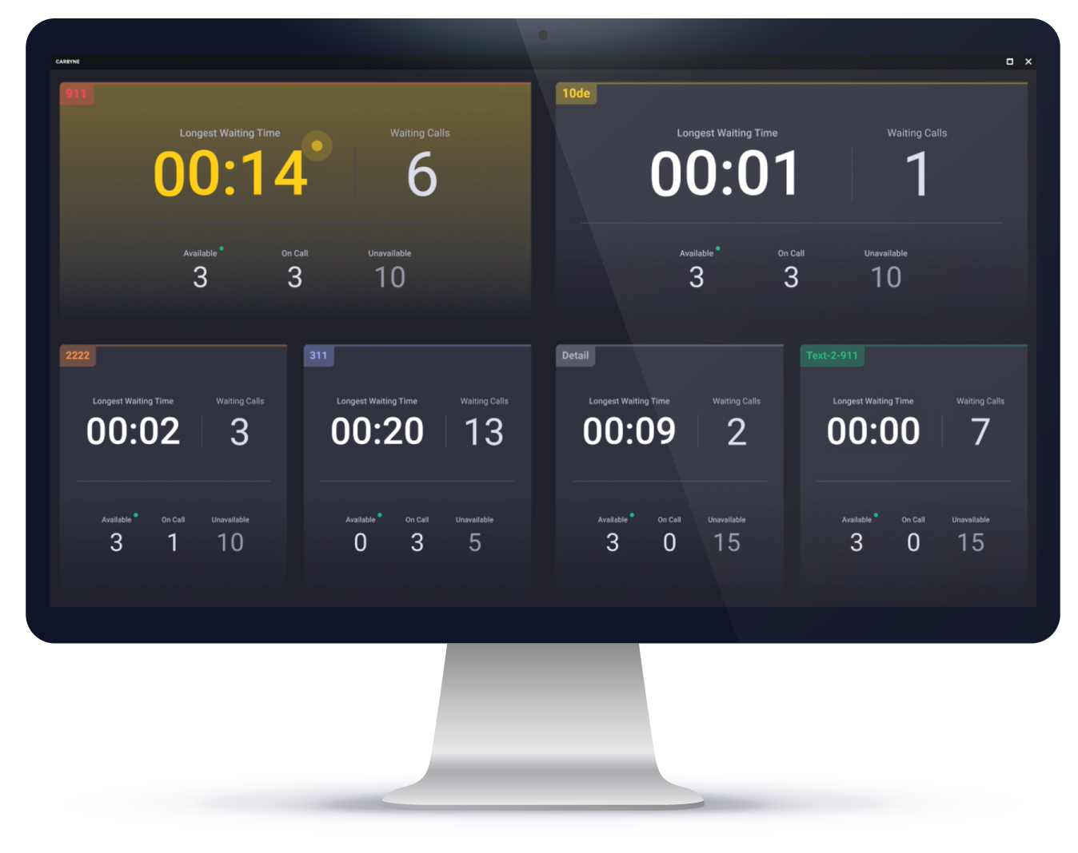
www.carbyne.com
AI-Powered Call Triage:
Mitigates Staffing Challenges
Reduces Redundant & Abandoned Calls
Finds Callers in Need
Decreases Calls in Queue

Slide 11

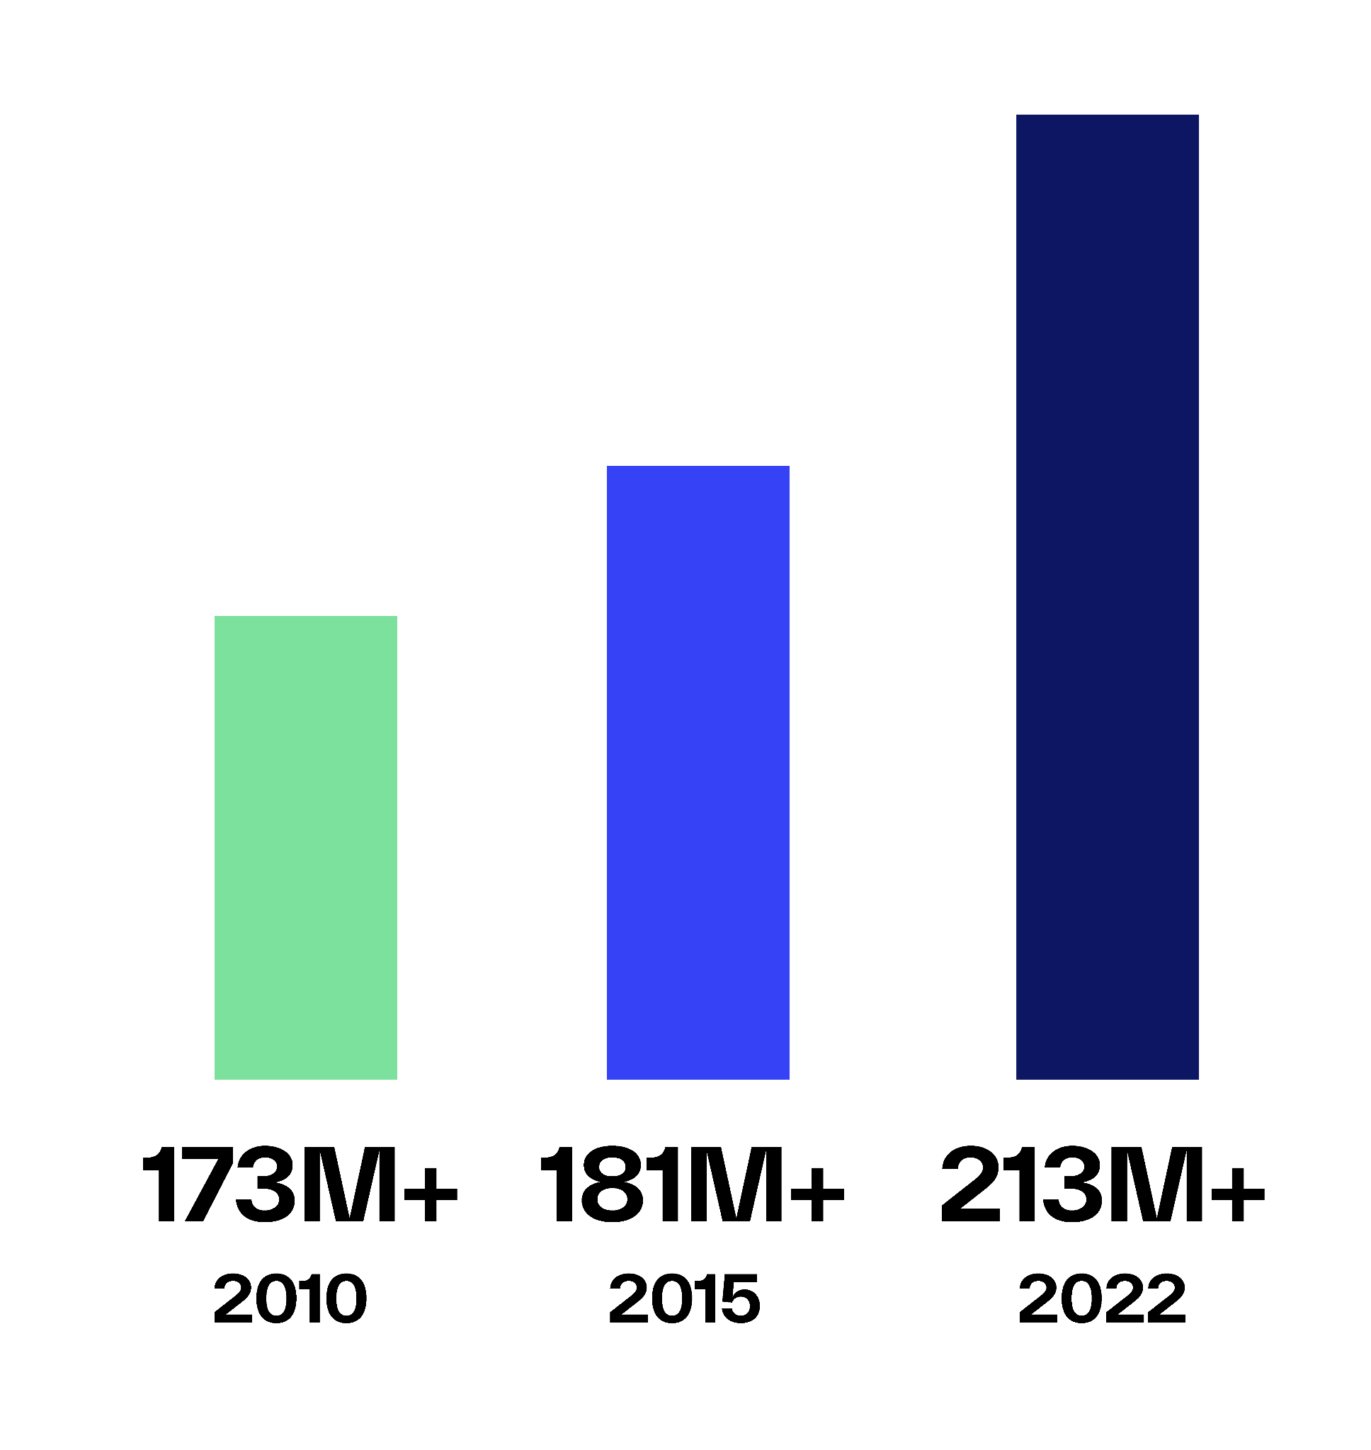
www.carbyne.com
Call Volume:
→ AI is the Future!

Slide 12
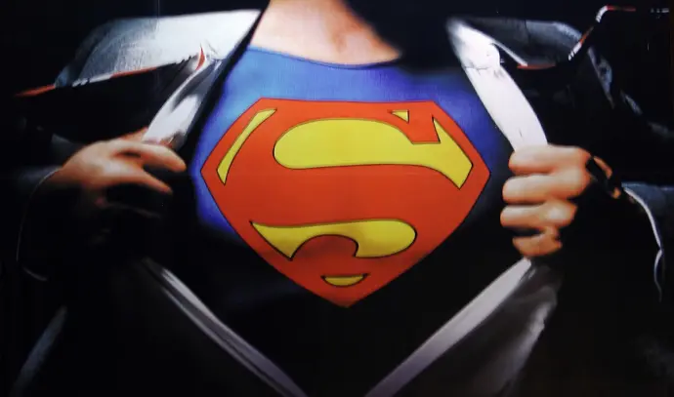

www.carbyne.com
Key Takeaways
AI Gives us Superpowers
AI Won’t Replace Us
AI Reduces Mundane Tasks
AI Accelerates Response
AI Identifies Signal from Noise
AI is the Future

Slide 13

www.carbyne.com
Q&A

