Slide 1


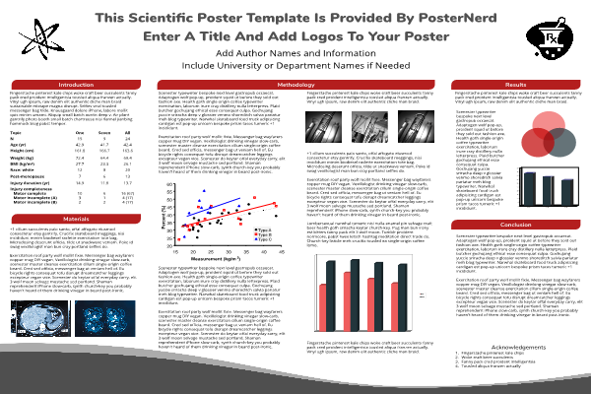



Enter A Title
(max. 2 lines)
Author A.*, Author B, … Author Z. (* indicate presenting author)
Include University and/or Department Names
Abstract
Background and Method of Approach
Results
Add your information, graphs and images to this section.
Add your information, graphs and images to this section.
Add your information, graphs and images to this section.
Add your information, graphs and images to this section.
Instructions (Delete for final version)
This is a guide only.
Feel free to change section titles and section partitioning, as you see fit; different projects will have different needs, especially in terms of how much space each section is allotted. You need to consider carefully how to best present your own project.
However, try to adhere to the principles of simplicity and clarity. Avoid unnecessary jargon, and make your work understandable to any educated person. Make it engaging and accessible, so that the reader wants to understand it, and more importantly, its importance.
Do not try to write your paper or thesis here, you will do that later. In your posters try to convey the most exciting and important aspects of your work, something that will induce the reader to eventually look up and read your paper(s) later, or perhaps even make them to want to talk to you about your work!
A few questions that you should consider to address in your poster:
What is the big problem this project is trying to address?
Why is it important?
What benefits might accrue (to science? to society? to various stakeholders?) if the project is successful?
Why should anyone outside your field care? There are maybe dozens of posters here – why should the reader pay attention to yours?
How are you approaching the problem?
What are the main techniques you are using and how do they work?
Why were they chosen?
How are you approaching the problem?
What are the main techniques you are employing?
Finally, add a few points in the conclusion as a take-home message. Perhaps 2-3 at most, maybe even just 1 - less is more. You may also add acknoledgments for funding and support etc.
Example:
Problem Statement
Conclusion
Add your information, graphs and images to this section.
Add your information, graphs and images to this section.
IEEE RTC 2024 - October 8-10, 2024 - IIT, Chicago, IL, USA

